Slide 1
Template Instructions
HOW TO MAKE THIS TEMPLATE YOUR OWN
DELETE THIS SECTION ONCE YOU ARE COMFORTABLE WITH EDITING THE PROJECT WITHOUT GUIDANCE

Slide 2
Template Instructions
PART 1
a// MAIN TEMPLATE
Access the Slide Master by selecting View > Slide Master. Select the top slide on the panel to the left hand side of YOUR screen. From this menu you will be able to add or remove elements from the main template design as well as edit elements such as the company name placeholder, date format and page number found in the footer of the template. When you are done editing in the Slide Master view, click on Close Master View on the top task bar.
b// LABEL SLIDE
All the text on the template slides can be directly edited by clicking on the specific text.
Replace the background image by right-clicking on the current image and selecting Format Background’. Follow the prompts on the pop-up menu. For a extensive selection of royalty-free stock images, visit one of the following stock image websites:
Negative Space
Pic Jumbo
Kaboompics
Pexels
Freepik
c// CONTENT SLIDES
All the text on the content slides can be directly edited by clicking on the specific text.
Icons can be replaced to meet YOUR specific need. To change an icon, simply right-click on the icon and select Change Graphic from the pop-up menu. Choose From Icons. This option will take you to PowerPoint’s built-in Icon Library where you can select a new icon from their wide variety of themes. Click on Insert Icon to replace. You can change icon styles and colours by simply clicking on them to enter the style menu.

Slide 3
Template Instructions
PART 2
d// SLIDE LAYOUTS
New slides can be inserted into this template by selecting New Slide on the task bar and picking the most appropriate layout.
Add, duplicate or delete slides by right-clicking on their thumbnail preview to the left of YOUR screen and selecting the action that you wish to perform.
Slides can be re-arranged by clicking and dragging their thumbnails up or down on the layout sequence.
The page numbering will automatically be updated when slides are added or removed to YOUR presentation.
e// SAVING YOUR PROJECT
Make sure to save this template under a file domain of YOUR choice on YOUR own computer or flash drive. Go to File > Save As and choose a domain and file name before clicking on Save. From here onwards you can save by pressing Ctrl + S on YOUR keyboard as a shortcut. Save in regular intervals to avoid losing any important data in the event of a software failure.
To save YOUR final presentation in PDF format, go to File > Save As and then, in the drop-down menu, choose the PDF format and then click on Save.
f// TROUBLESHOOTING
This template was created for you to merely copy infographics or visual elements from or to be able to use as a whole by adding or removing slides to meet YOUR individual needs. In the case of a slide formatted to a point where the fonts and colours have been changed and moved too far from the original look, you can reset the slide to the original formatting by clicking on Reset in the Slides Section of the Home toolbar.

Slide 5
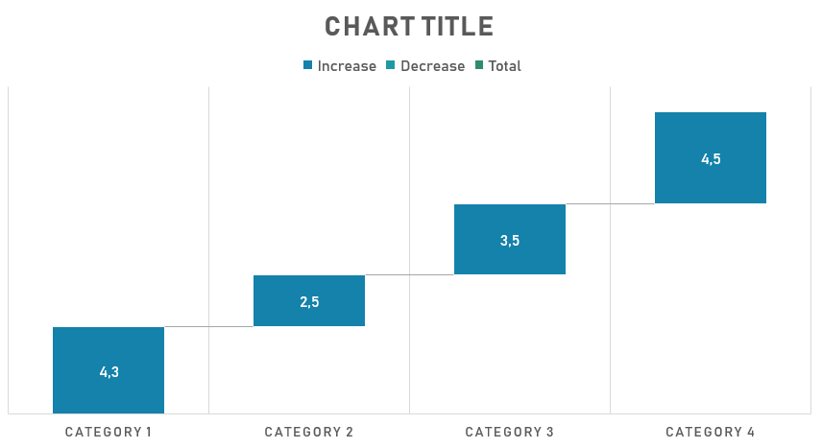

Slide 8


Slide 11
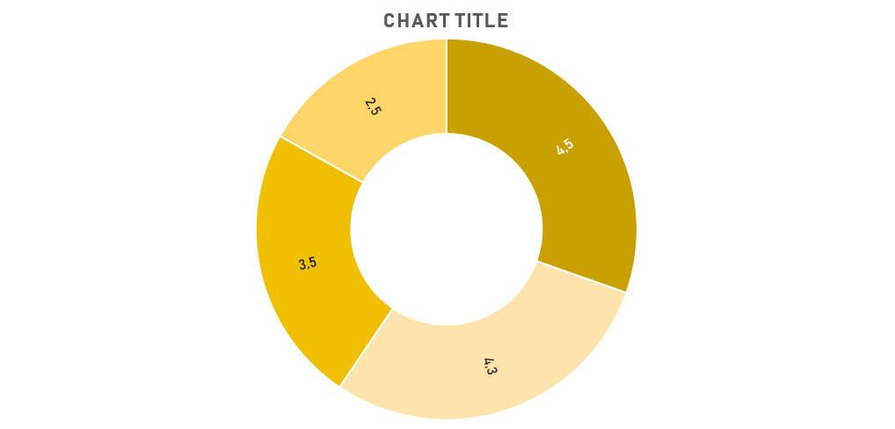

Slide 13
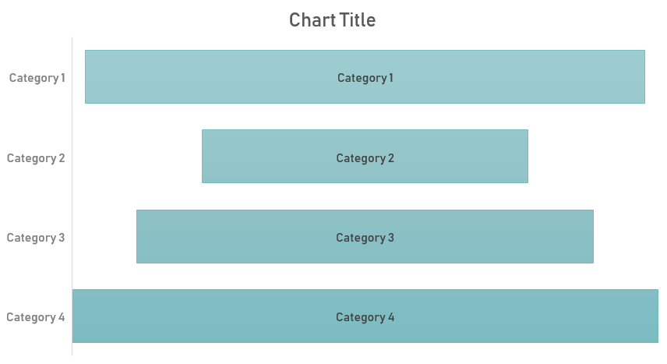

Slide 14
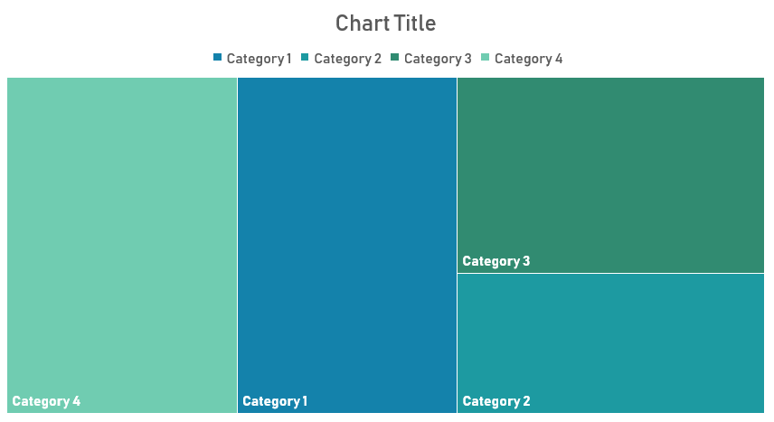

Slide 16
